Slide 1


GENERAL SERVICES MARKETING PLAN
COURIER MANAGEMENT SYSTEM
Amalu Shaji
22pmc110

Slide 2

ABSTRACT
This project deals with the ‘Courier management System’. The system will be used for day to day management activities like branch details,staff details,add courier and status of courier.Actually It is not easy to do this process manually because it would become very tough. Hence it is recommended to automate the process by developing the relevant software as the world is moving from manual working to information and technology era where computerization becomes important in all walks of life.

Slide 3


REQUIREMENTS
Courier management system is divided into two modules:
1.Staff module
2.Admin module
Staff module details are:
Dashboard
Add courier
Change status of courier
Search Courier
Edit profile

Slide 4

Admin Module details:
Dashboard
Add branch details
Add staff details
Manage branch details
Admin can view the staff and courier details

Slide 5
FEATURES
Easy to add courier details
See the reports
Updates
Change status of courier
It is the most software application for managing courier management.
The new system is totally computerized system.

Slide 6
TECHNICAL ASPECTS
Front end
HTML
CSS
BOOTSTRAP
Back end
Python Django
Database
SQLite3
Jazzmin

Slide 7
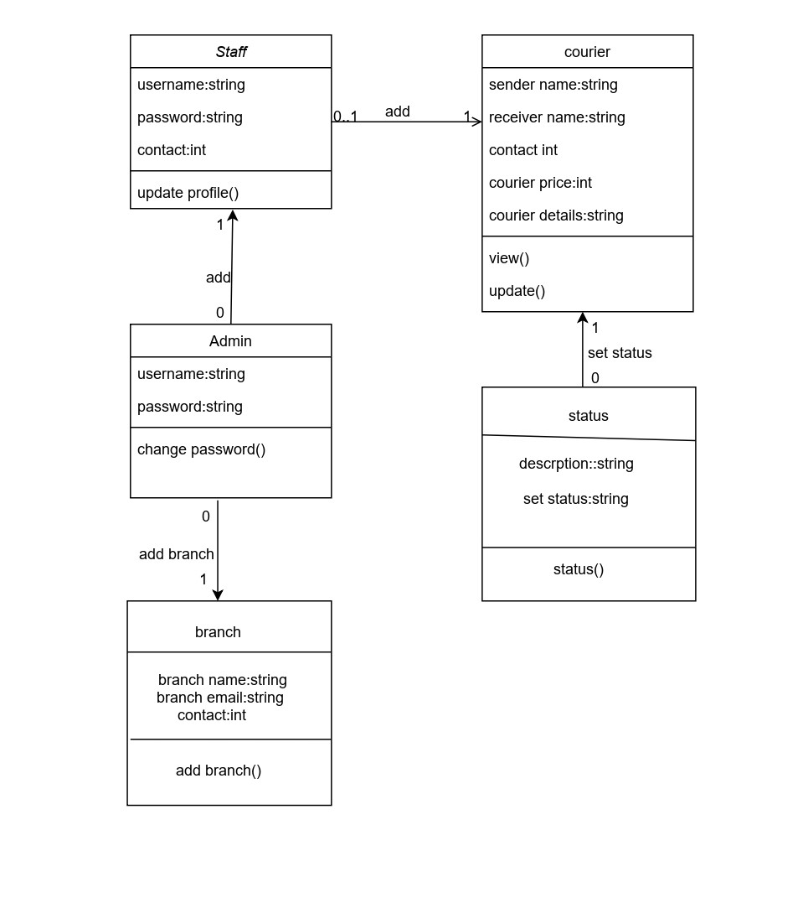
CLASS DIAGRAM

Slide 8
CHALLENGES
User Interface
Validation Mechanisms

Slide 9
SCREENSHOTS

Slide 10
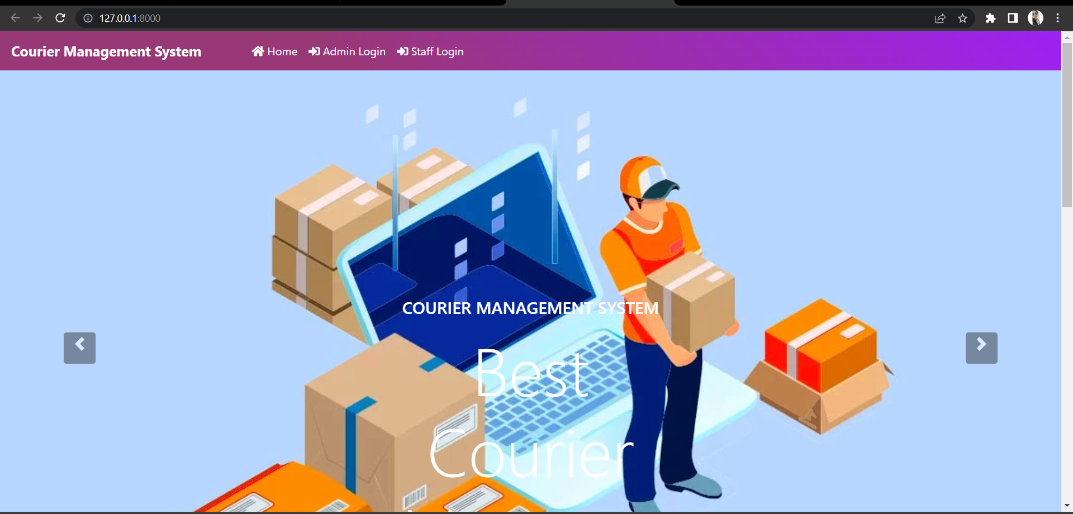
HOME PAGE

Slide 11
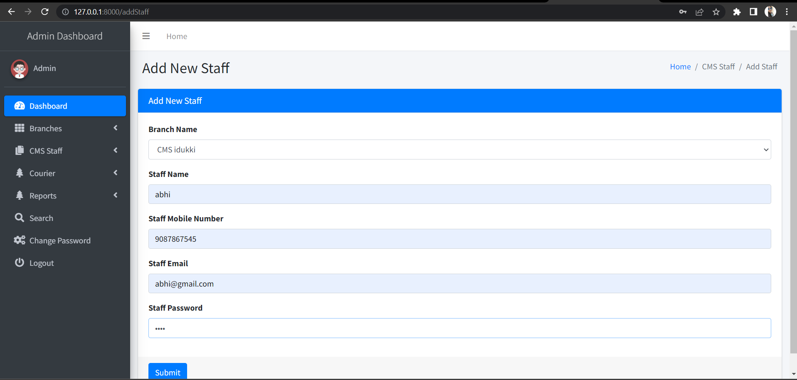
STAFF REGISTRATION

Slide 12
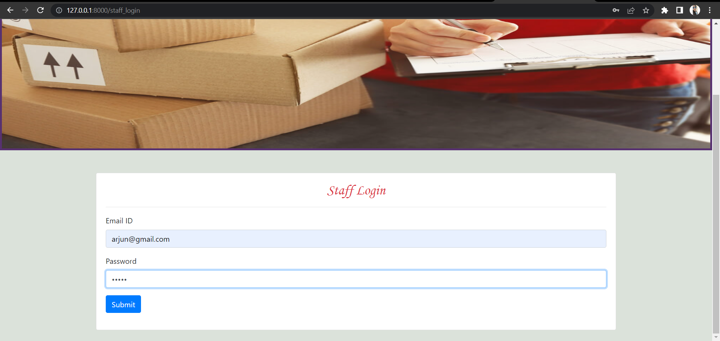
STAFF LOGIN

Slide 13
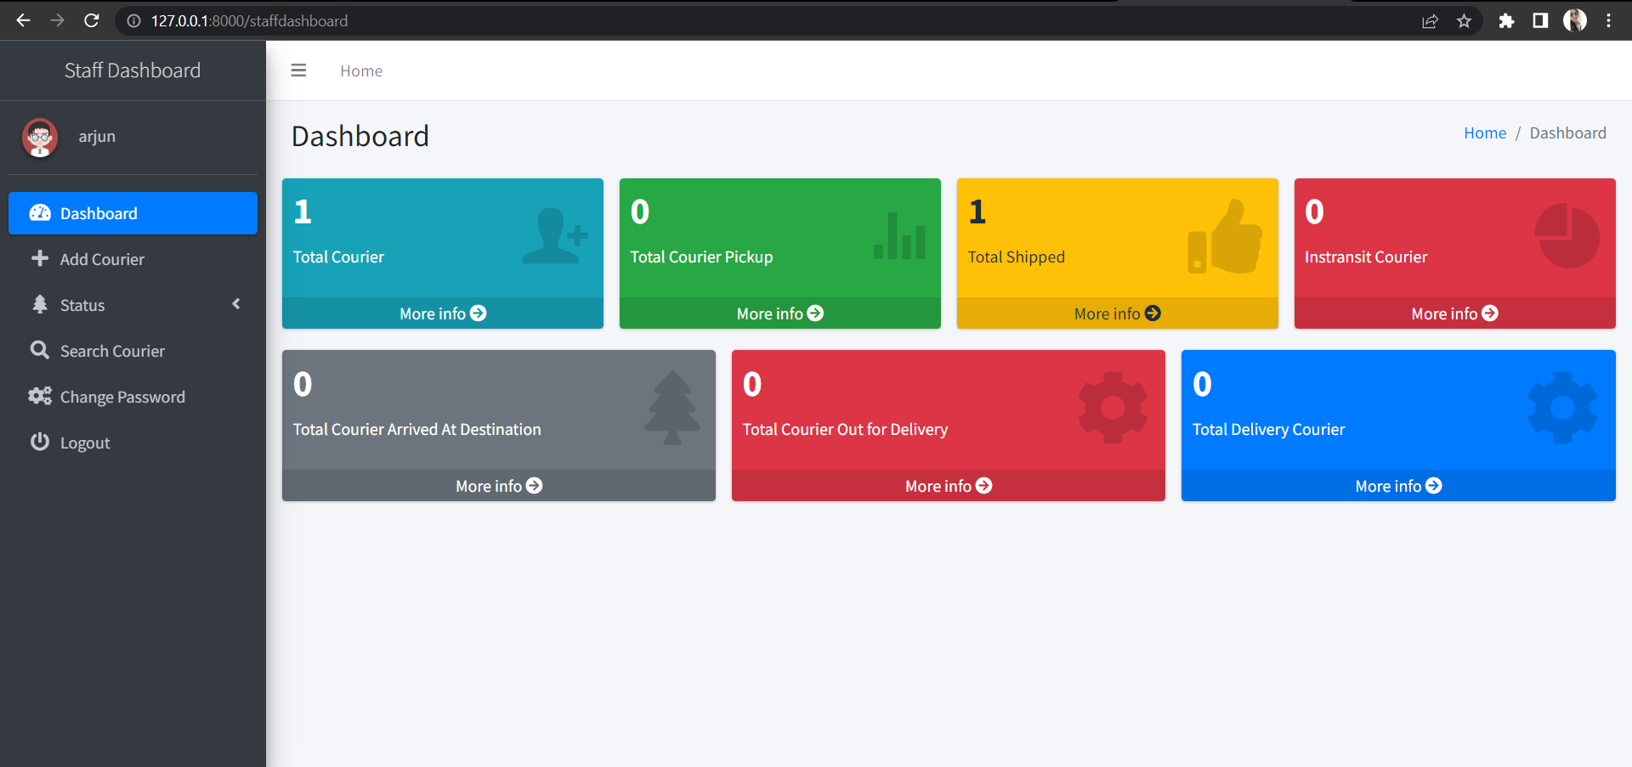
STAFF DASHBOARD

Slide 14
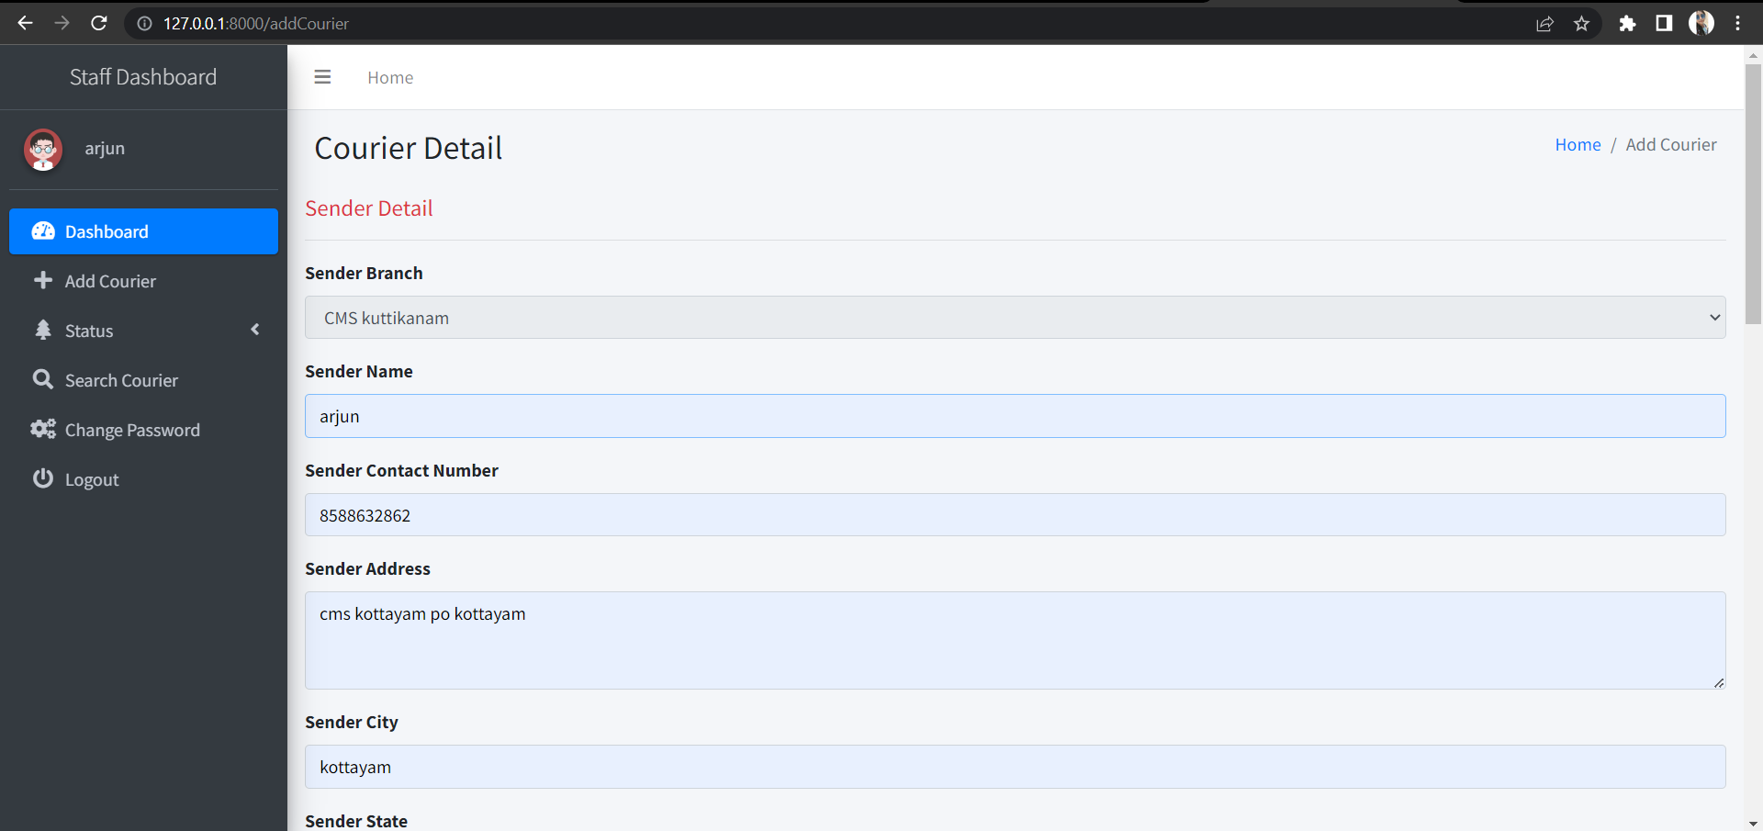
ADD COURIER

Slide 15
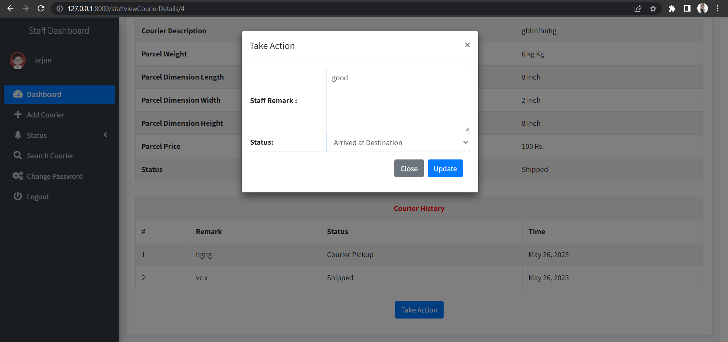
STATUS PAGE

Slide 16
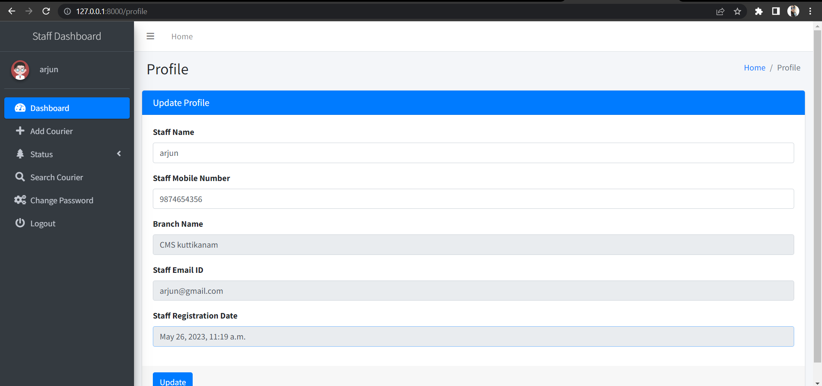
EDIT PROFILE

Slide 17
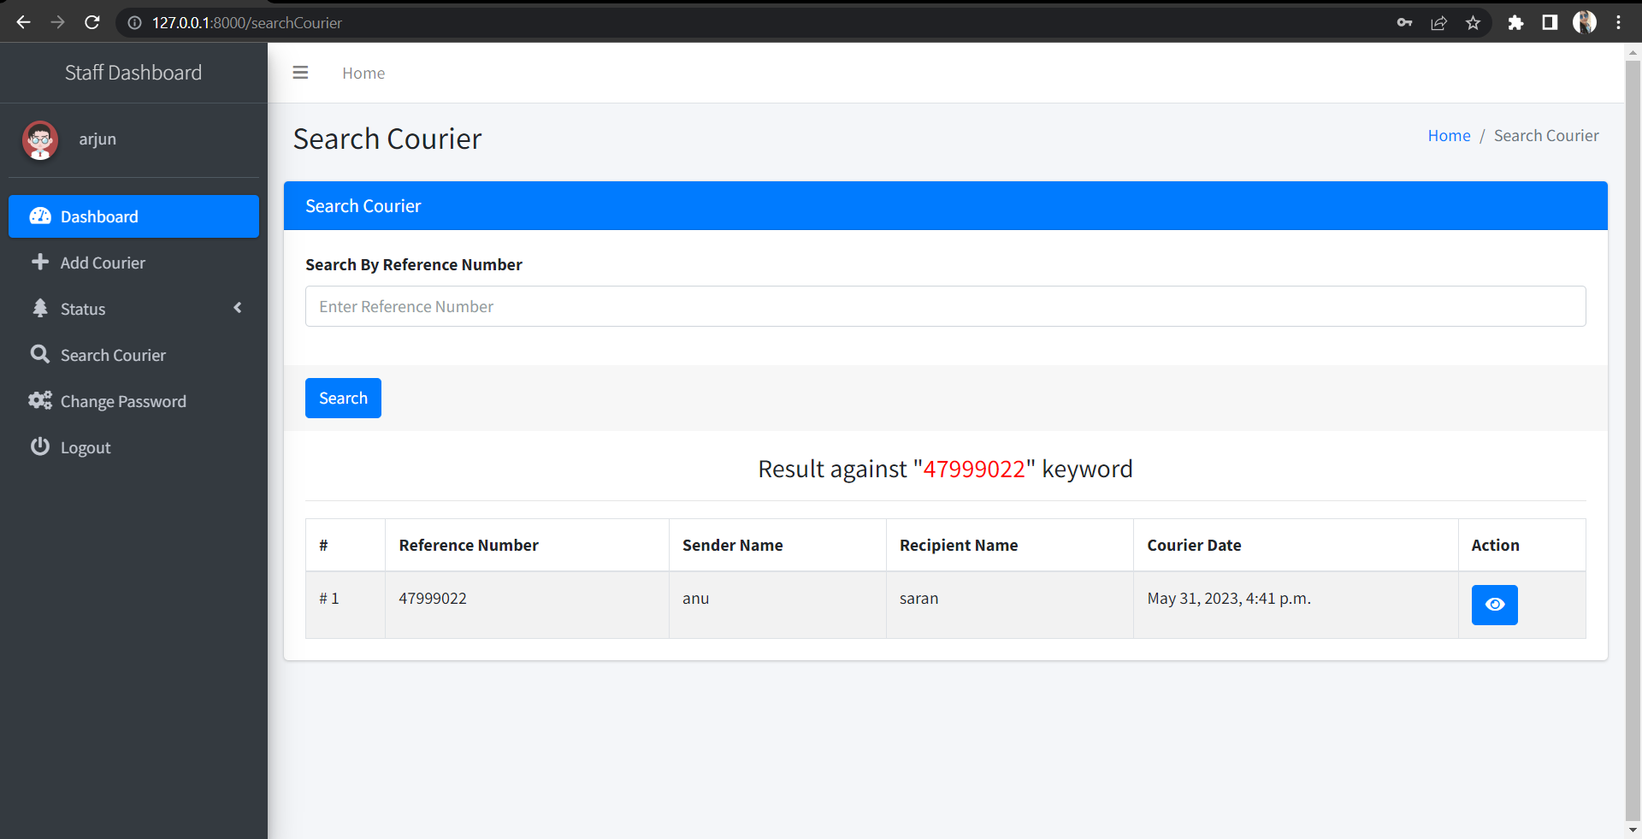
SEARCH COURIER PAGE

Slide 18
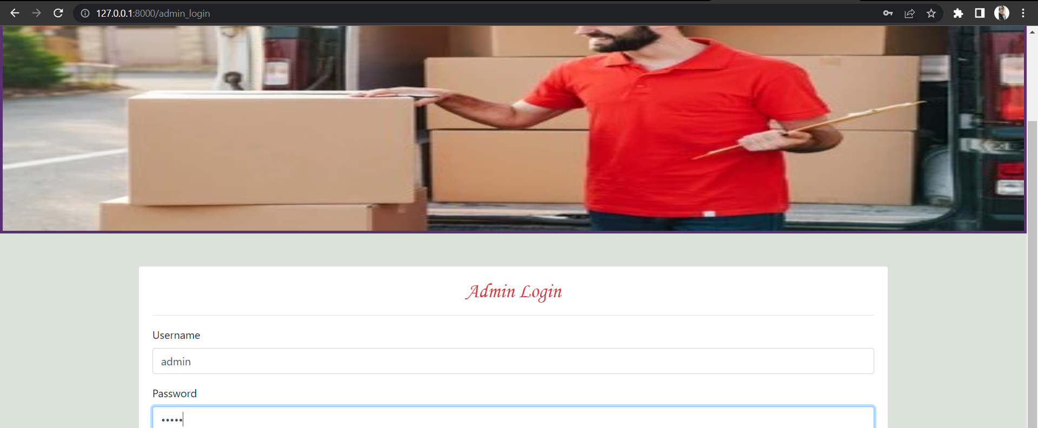
ADMIN LOGIN

Slide 19
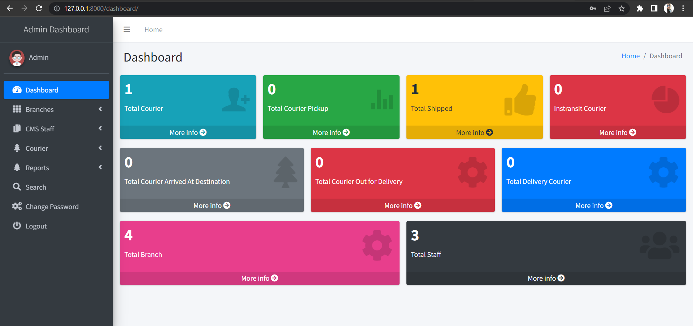
ADMIN DASHBOARD

Slide 20
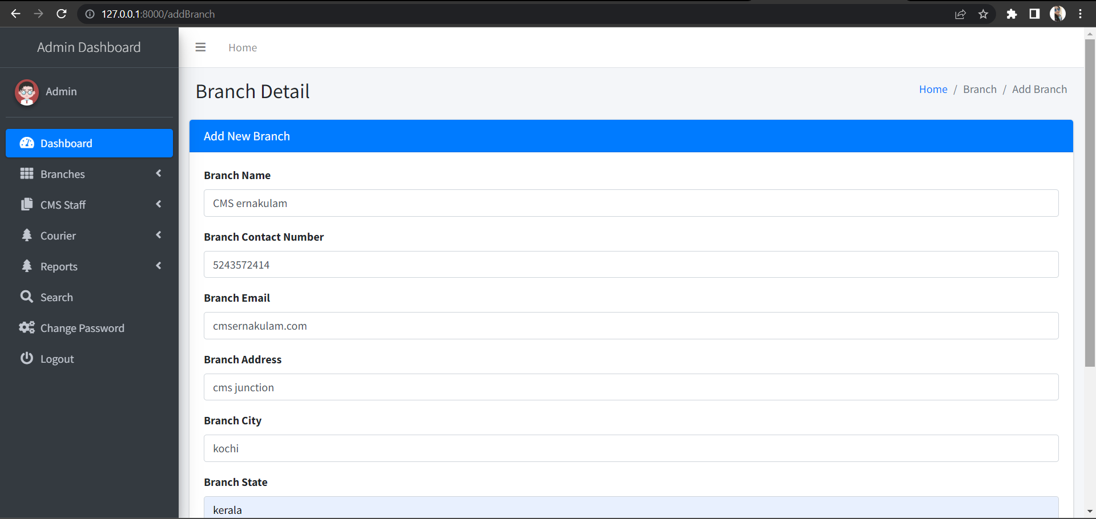
ADD BRANCH

Slide 21
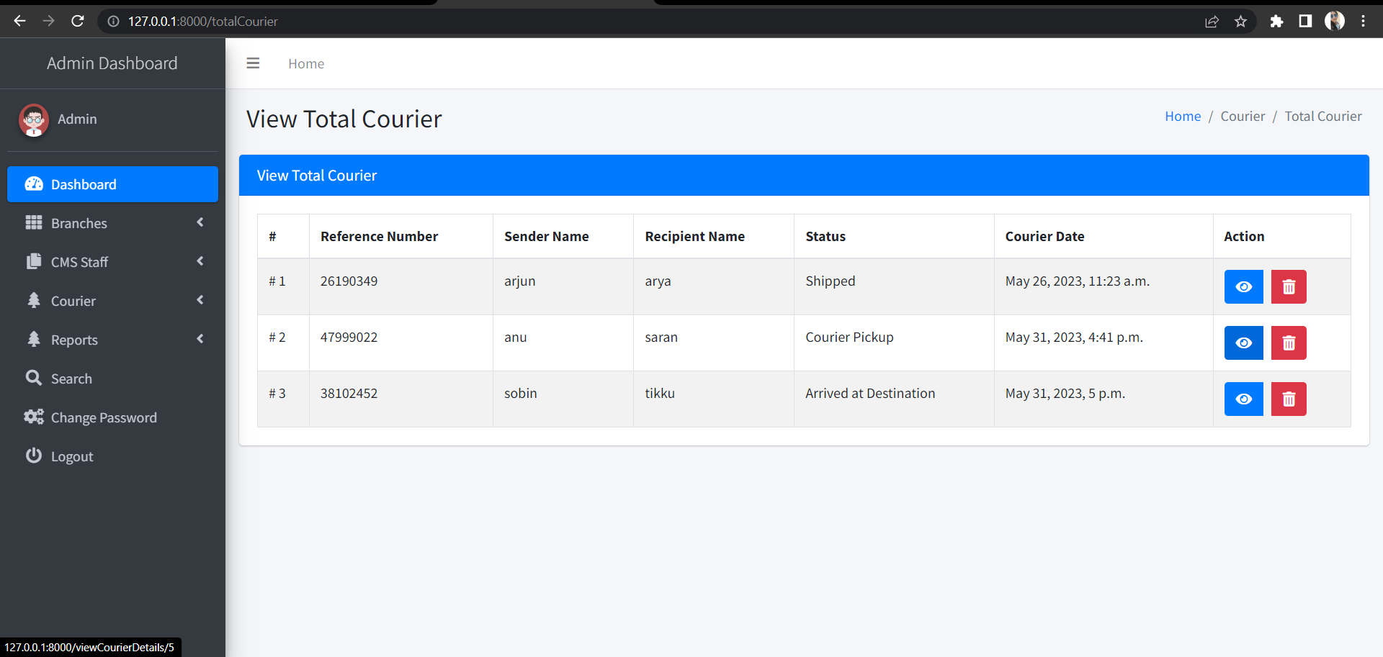
COURIER PAGE

Slide 22
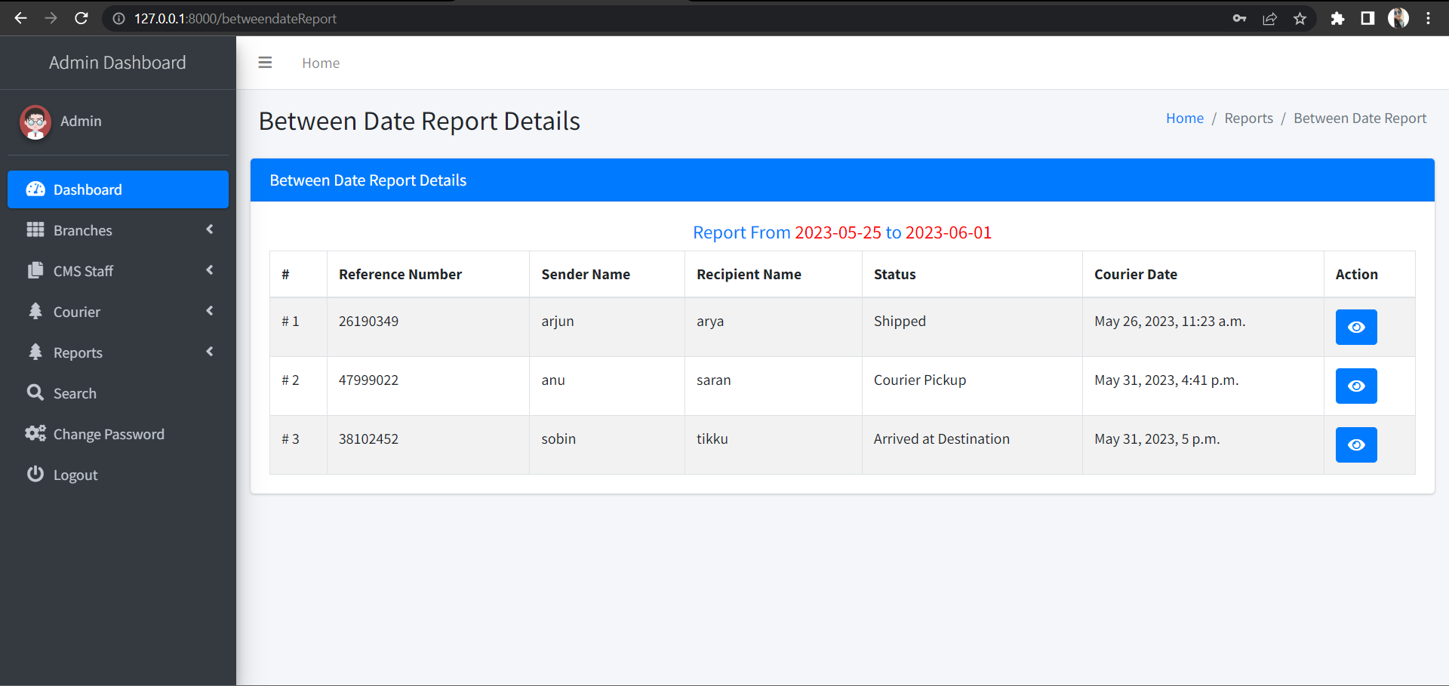
REPORT PAGE

Slide 23
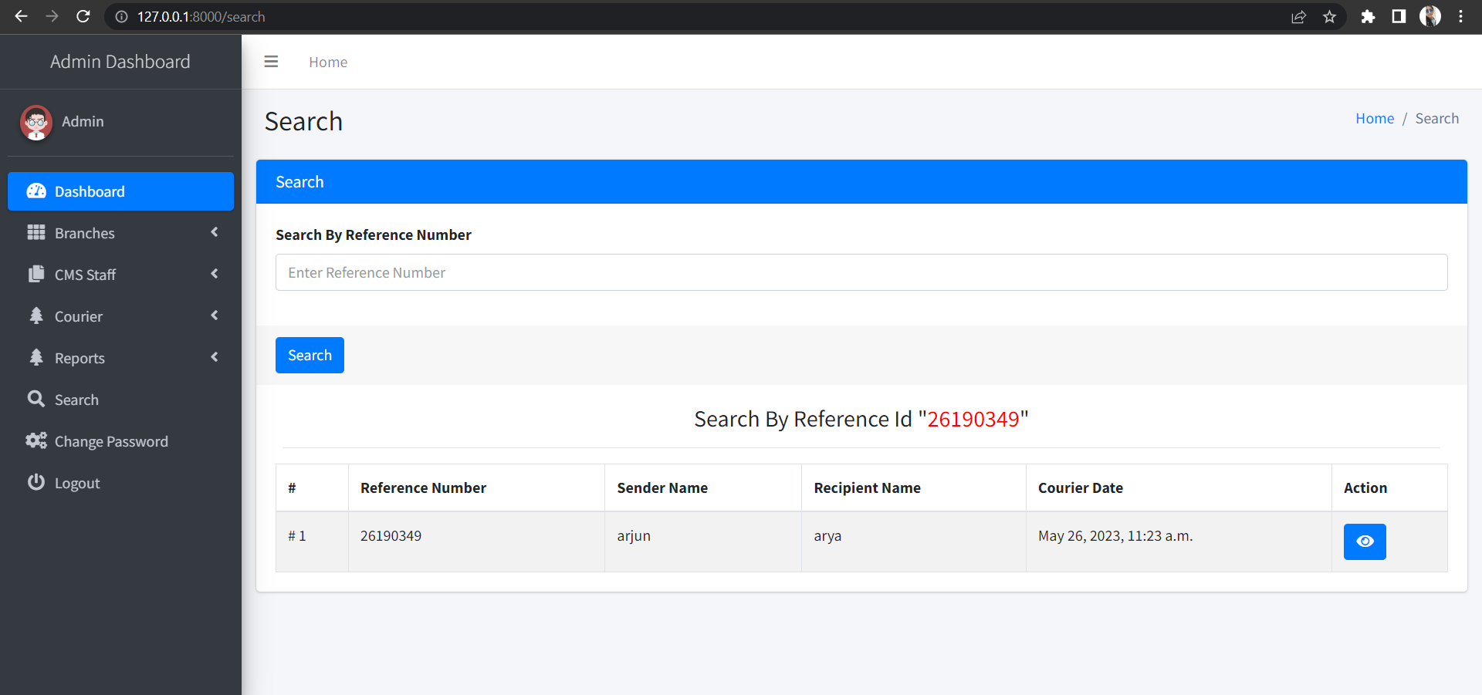
SEARCH PAGE

Slide 24
FUTURE ENHANCEMENT
Social Media Integration
Report Generation
New user
Payment

Slide 25
CONCLUSION
The entire project has been developed and deployed as per the requirements stated by the user, it is found to be bug free as per then testing standards that is implemented. Any specification-untraced errors will be concentrated in the coming versions, which are planned to be developed in near future. The system at present does not take care of the money payment methods, the application of the credit card transactions is applied as a developmental phase in the coming days. The system needs more elaborative technically for its inception and evolution.

Slide 26
REFERENCES
https://docs.djangoproject.com/en/4.1/intro/tutorial01/
https://www.cargoerp.in/Courier-Booking-Management-Software.html
getbootstrap.com

Slide 27

THANK YOU

